Slide 1

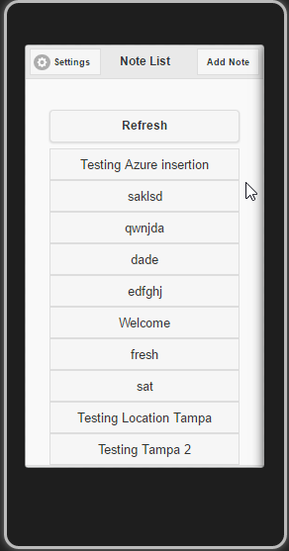
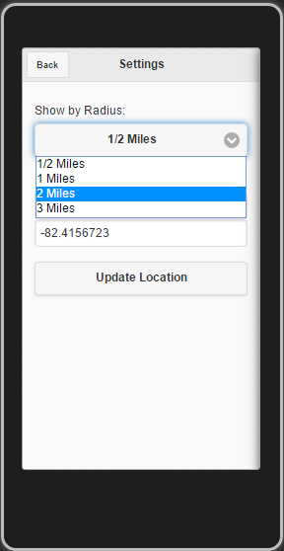
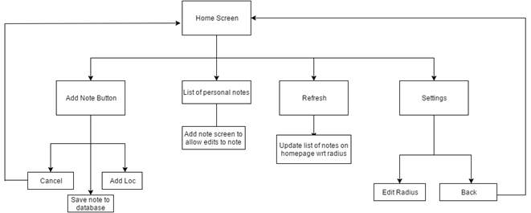
Senior Project: Trunica Notepad Mobile Application Raj Desai, David Nwagbuo, Antoninus Lamptey
rajdesai@mail.usf.edu, nwagbuo@mail.usf.edu, antoninus@mail.usf.edu Department of Computer Science and Engineering
Background
Diagrams
Implementation and Design
Trunica is a local Tampa based company which specializes in creating applications and helping local businesses by providing their mobile expertise to advertise the businesses. Since the company specializes in creating applications, our project is to create a mobile application using one of their most common software called Apache Cordova.
1. Figure 1 shows the home screen which displays all the current notes in a given radius of the user as well as any locally stored notes. There is a refresh button on this screen that updates the list of notes with the user’s new location and/or selected radius.
2. The home screen features a “Settings” button on the top left that allows to user to see their current GPS coordinates as well as edit the radius in which notes are scanned for on the cloud. This can be seen in figure 2..
3. The “Add Note” option in the top right corner allows user to create a brand new note which will lead them to a new screen giving a two sets of text boxes; one for the subject, which is essentially the title of the note and the second for the actual content of the note.
4. There is also a “Add Location” button on the top right of the Add Note screen that allows the user to attach their current GPS coordinates to the note.
5. In addition, there is also a “cancel” or “back” button on the top left side of the “Add Note” and “Settings” pages that take the users back to the home screen with their notes
6. Figure 3 is a flowchart that illustrates the different buttons and options available to the user on each screen. It ties together all the design points above and shows how each screen interacts with each other.
Problem
Develop a mobile application using the Cross Platform Environment called Apache Cordova in Visual Studio 2015. The mobile application has to incorporate the functionality of a notepad application which will need to utilize geo-location. This application will allow users to take notes anywhere they desire and the notes would add a geo-tag to them to pinpoint locations.
Requirements
To develop a mobile application that will function as a notepad (i.e. Notepad Application) which will be developed/deployed in the Apache Cordova software (A cross-platform environment).
The mobile application needs to incorporate the concept of geo-location. The longitude and latitude will be recorded from the location that a specific note is made.
The notes saved in the notepad application would be pushed to the Azure cloud database. Usually in a given time frame of 1-2 minutes.
Users should be able to access any notes in a given radius of 30 - 50 miles depending on the specific location.
The application will have a privacy lock where the user decides whether or not to allow other users at a given location to access their notes.
The application should also have a delay note feature which would allow the user to write a note presumably at home or any other place after visiting a specific location (i.e., A person writes a note about a restaurant at home after eating dinner at that restaurant).
Figure 1
Figure 2
Figure 3
Senior Project (CIS 4910) Spring 2016

